Slide 1

What is Statistics?
Chapter 1
McGraw-Hill/Irwin
Copyright © 2012 by The McGraw-Hill Companies, Inc. All rights reserved.

Slide 2
Learning Objectives
LO1 List ways statistics is used.
LO2 Know the differences between descriptive and inferential
statistics.
LO3 Understand the differences between a sample and a
population.
LO4 Explain the difference between qualitative and quantitative
variables.
LO5 Compare the differences between discrete and continuous
variables.
LO6 Recognize the levels of measurement in data.
1-<number>

Slide 3

Why Study Statistics?
LO1 List ways statistics is used.
Why Study Statistics?
Numerical information is everywhere
Statistical techniques are used to make decisions that affect our daily lives
The knowledge of statistical methods will help you understand how decisions are made and give you a better understanding of how they affect you.
No matter what line of work you select, you will find yourself faced with decisions where an understanding of data analysis is helpful.
Some examples of the need for data collection.
Research analysts for Merrill Lynch evaluate many facets of a particular stock before making a “buy” or “sell” recommendation.
The marketing department at Colgate-Palmolive Co., a manufacturer of soap products, has the responsibility of making recommendations regarding the potential profitability of a newly developed group of face soaps having fruit smells.
The United States government is concerned with the present condition of our economy and with predicting future economic trends.
Managers must make decisions about the quality of their product or service.
1-<number>

Slide 4

What is Meant by Statistics?
LO1
In the more common usage, statistics refers
to numerical information
Examples: the average starting salary of college graduates, the number of deaths due to alcoholism last year, the change in the Dow Jones Industrial Average from yesterday to today, and the number of home runs hit by the Chicago Cubs during the 2007 season.
We often present statistical information in a graphical form for capturing reader attention and to portray a large amount of information.
1-<number>

Slide 5

Types of Statistics – Descriptive Statistics and Inferential Statistics
LO2 Know the differences between descriptive and inferential statistics.
Descriptive Statistics - methods of organizing, summarizing, and presenting data in an informative way.
Inferential Statistics: A decision, estimate, prediction, or generalization about a population, based on a sample.
Note: In statistics the word population and sample have a broader meaning. A population or sample may consist of individuals or objects
1-<number>

Slide 6

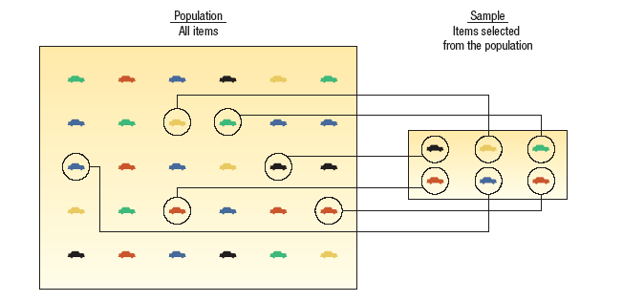
Population versus Sample
LO3 Understand the differences between a sample and a population.
A population is a collection of all possible individuals, objects, or measurements of interest.
A sample is a portion, or part, of the population of interest
1-<number>

Slide 7
Why take a sample instead of studying every member of the population?
LO3
Prohibitive cost of census
Destruction of item being studied may be required
Not possible to test or inspect all members of a population being studied
Using a sample to learn something about a population is done extensively in business, agriculture, politics, and government.
EXAMPLE: Television networks constantly monitor the popularity of their programs by hiring Nielsen and other organizations to sample the preferences of TV viewers.
1-<number>

Slide 8

Types of Variables
LO4 Explain the difference between qualitative and quantitative variables.
Qualitative or Attribute variable - the characteristic being studied is nonnumeric.
EXAMPLES: Gender, religious affiliation, type of automobile owned, state of birth, eye color are examples.
Quantitative variable - information is reported numerically.
EXAMPLES: balance in your checking account, minutes remaining in class, or number of children in a family.
1-<number>

Slide 9

Quantitative Variables - Classifications
LO5 Compare the differences between discrete and continuous variables.
Quantitative variables can be classified as either discrete or continuous.
Discrete variables: can only assume certain values and there are usually “gaps” between values.
EXAMPLE: the number of bedrooms in a house, or the number of hammers sold at the local Home Depot (1,2,3,…,etc).
Continuous variable can assume any value within a specified range.
  EXAMPLE: The pressure in a tire, the weight of a pork chop, or the height of students in a class.
1-<number>

Slide 10

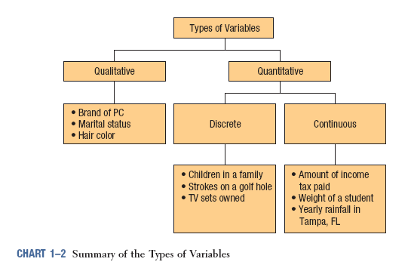
Summary of Types of Variables
LO4 and LO5
1-<number>

Slide 11

Four Levels of Measurement
LO6 Recognize the levels of measurement in data.
Nominal level - data that is classified into categories and cannot be arranged in any particular order.
EXAMPLES:: eye color, gender, religious affiliation.
Ordinal level – data arranged in some order, but the differences between data values cannot be determined or are meaningless.
EXAMPLE: During a taste test of 4 soft drinks, Mellow Yellow was ranked number 1, Sprite number 2, Seven-up number 3, and Orange Crush number 4.
Interval level - similar to the ordinal level, with the additional property that meaningful amounts of differences between data values can be determined. There is no natural zero point.
EXAMPLES: Temperature on the Fahrenheit scale.
Ratio level - the interval level with an inherent zero starting point. Differences and ratios are meaningful for this level of measurement.
EXAMPLES: Monthly income of surgeons, or distance traveled by manufacturer’s representatives per month.
1-<number>

Slide 12



Nominal and Ordinal Level Data
LO6
NOMINAL LEVEL DATA
Properties:
Observations of a qualitative variable can only be classified and counted.
There is no particular order to the labels.
ORDINAL LEVEL DATA
Properties:
Data classifications are represented by sets of labels or names (high, medium, low) that have relative values.
Because of the relative values, the data classified can be ranked or ordered.
1-<number>

Slide 13
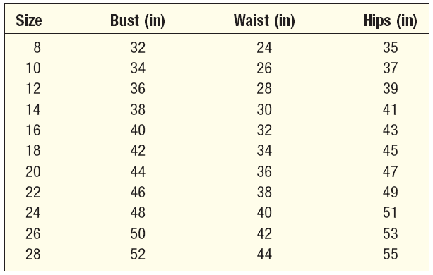
Interval and Ratio Level Data
LO6
INTERVAL LEVEL DATA
Properties:
Data classifications are ordered according to the amount of the characteristic they possess.
Equal differences in the characteristic are represented by equal differences in the measurements.
RATIO LEVEL DATA
Properties:
Data classifications are ordered according to the amount of the characteristics they possess.
Equal differences in the characteristic are represented by equal differences in the numbers assigned to the classifications.
The zero point is the absence of the characteristic and the ratio between two numbers is meaningful.
Practically all quantitative data is recorded on the ratio level of measurement. Ratio level is the “highest” level of measurement.
1-<number>

Slide 14
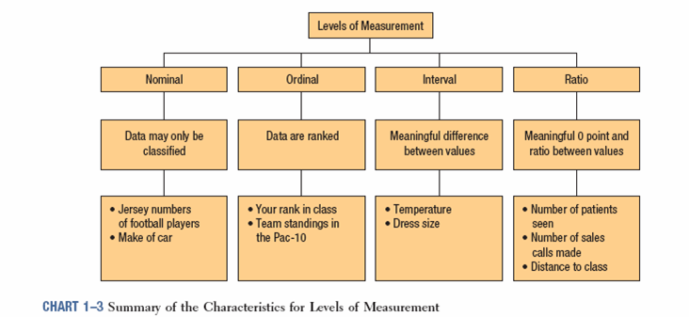
Summary of the Characteristics for Levels of Measurement
LO6
Why Know the Level of Measurement of a Data?
The level of measurement of the data dictates the calculations that can be
done to summarize and present the data.
To determine the statistical tests that should be performed on the data
1-<number>

